Slide 1
Main figures
For Traceable Selenium-Doped Microplastics and Nanoplastics with Environmentally Realistic Morphologies for Multi-Modal Detection in Complex Biological Matrices

Slide 3
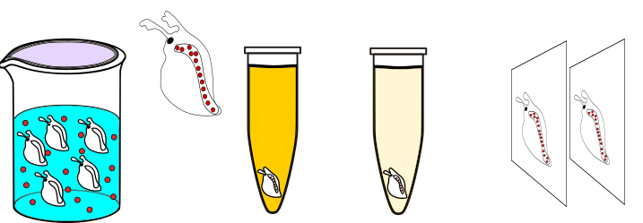
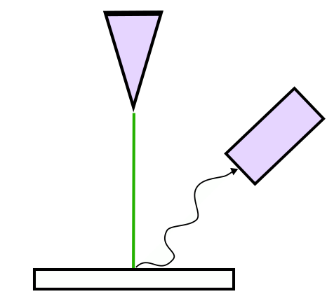
(a)
¹H-NMR, O-PTIR
¹H-NMR, O-PTIR, XPS
DLS, SEM
NTA, DLS, spICP-MS, SEM
p-phenylselenomethylstyrene (Se-M) + styrene
Free radical polymerization
Se-PS
Cryomilling
~<50 um
Se-PS-MNPs
Centrifugation
~<1 um
Se-PS-NPs
Leaching test
Daphnia magna exposure
(b)
ICP-MS
O-PTIR, ToF-SIMS
Daphnia magna exposure
Se-PS-MNPs: 0.1, 1, 10 ppm
Se-PS-NPs: 0.1, 1 ppm
~24 h fixation in Bouin’s solution
~ 1 h storage in PBS
Encased in OCT compound + cryotome
O-PTIR and ToF-SIMS slice analysis
Figure 1. Overview of the methodology. (a) General schematic for the generation of Se-doped polystyrene particles (Se-PS-MNPs and Se-PS-NPs), characterization methods and the practical application of the model MNPs; (b) Schematic of Daphnia magna exposure to Se-PS-MNPs and Se-PS-NPs and analysis of exposed daphnids. Red dots represent the Se-PS particles. Images not to scale.

Slide 4
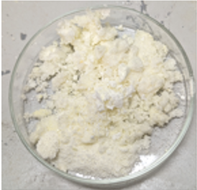
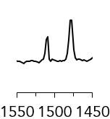
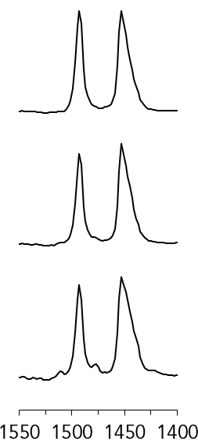
p-phenylselenomethylstyrene or Se-M
poly((Se-ST)-stat-ST) or Se-PS
¹H-NMR spectra
(a)
CDCl₃
Water
TMS
(b)
0.25% w/w
Intensity (a.u.)
Intensity (a.u.)
0.7% w/w
2.7% w/w
(c)
Chemical shift δ (ppm)
(d)
Chemical shift δ (ppm)
β
O-PTIR spectra
β
α
β
0.25% w/w
α
Intensity (a.u.)
Intensity (a.u.)
0.7% w/w
α
β
β
α
2.7% w/w
α
β
α
Wavenumber (cm⁻¹)
Wavenumber (cm⁻¹)
Figure 2. Characterization of synthesized p-phenylselenomethylstyrene monomer (Se-M) and Se-PS copolymer. (a) ¹H-NMR performed on a Bruker 400 Hz for purified p-phenylselenomethylstyrene (Se-M) in deuterated chloroform (CDCl₃) with 0.05% tetramethylsilane (TMS). Physical appearance of the Se-M in a glass Petri dish is shown as an inset in (a). Brown zone on spectra indicates the ²H on -Se-CH₂ at δ 4.09 ppm, trace water detected; (b) ¹H-NMR spectra for the Se-PS co-polymer poly((Se-ST)-stat-ST) with different Se-to-polymer weight ratios (0.25, 0.7, 2.7% w/w determined by XPS). Purple zone indicates the expected ²H on -Se-CH₂; (c) Average of 10 O-PTIR measured spectra of Se-M at with emphasis on ~1490 and 1510 cm⁻¹ . Empty range is seen between 2700 and 1800 cm⁻¹ as the O-PTIR does not have a laser within this range; (d) Average of 10 O-PTIR measured spectra on samples of 0.25, 0.7, 2.7% w/w Se-PS) with emphasis on 1453 cm⁻¹ . Light red α highlights the monosubstituted -SePh phenyl ring around 1510 cm⁻¹ and dark red β indicates the para-disubstituted phenyl ring ~ 1480 cm⁻¹. 2700 to 1800 cm⁻¹ was excluded.
Notes:
Se-Monomer and Se-PS data new version

Slide 5
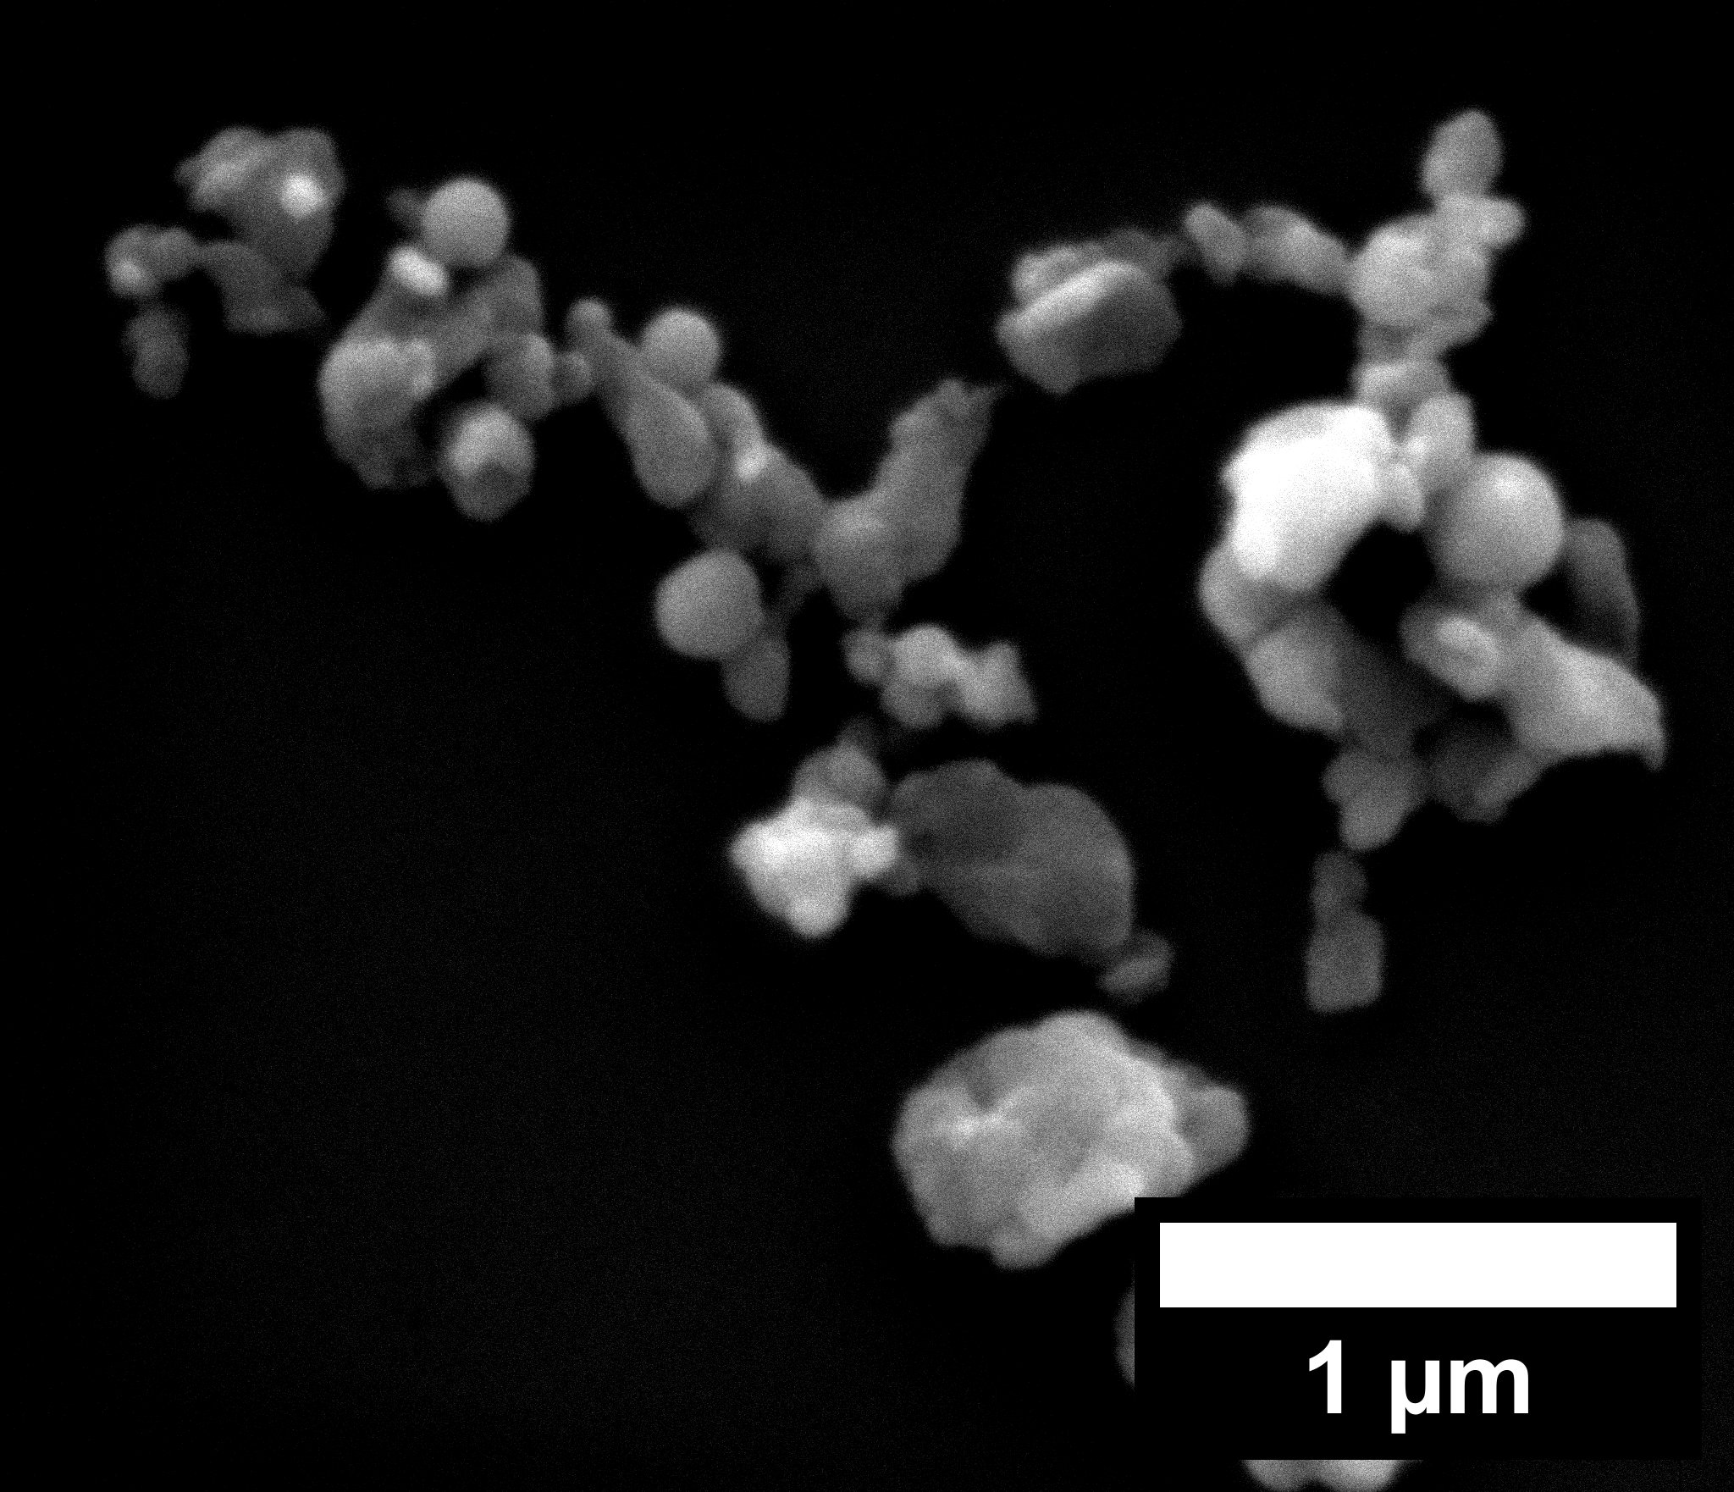
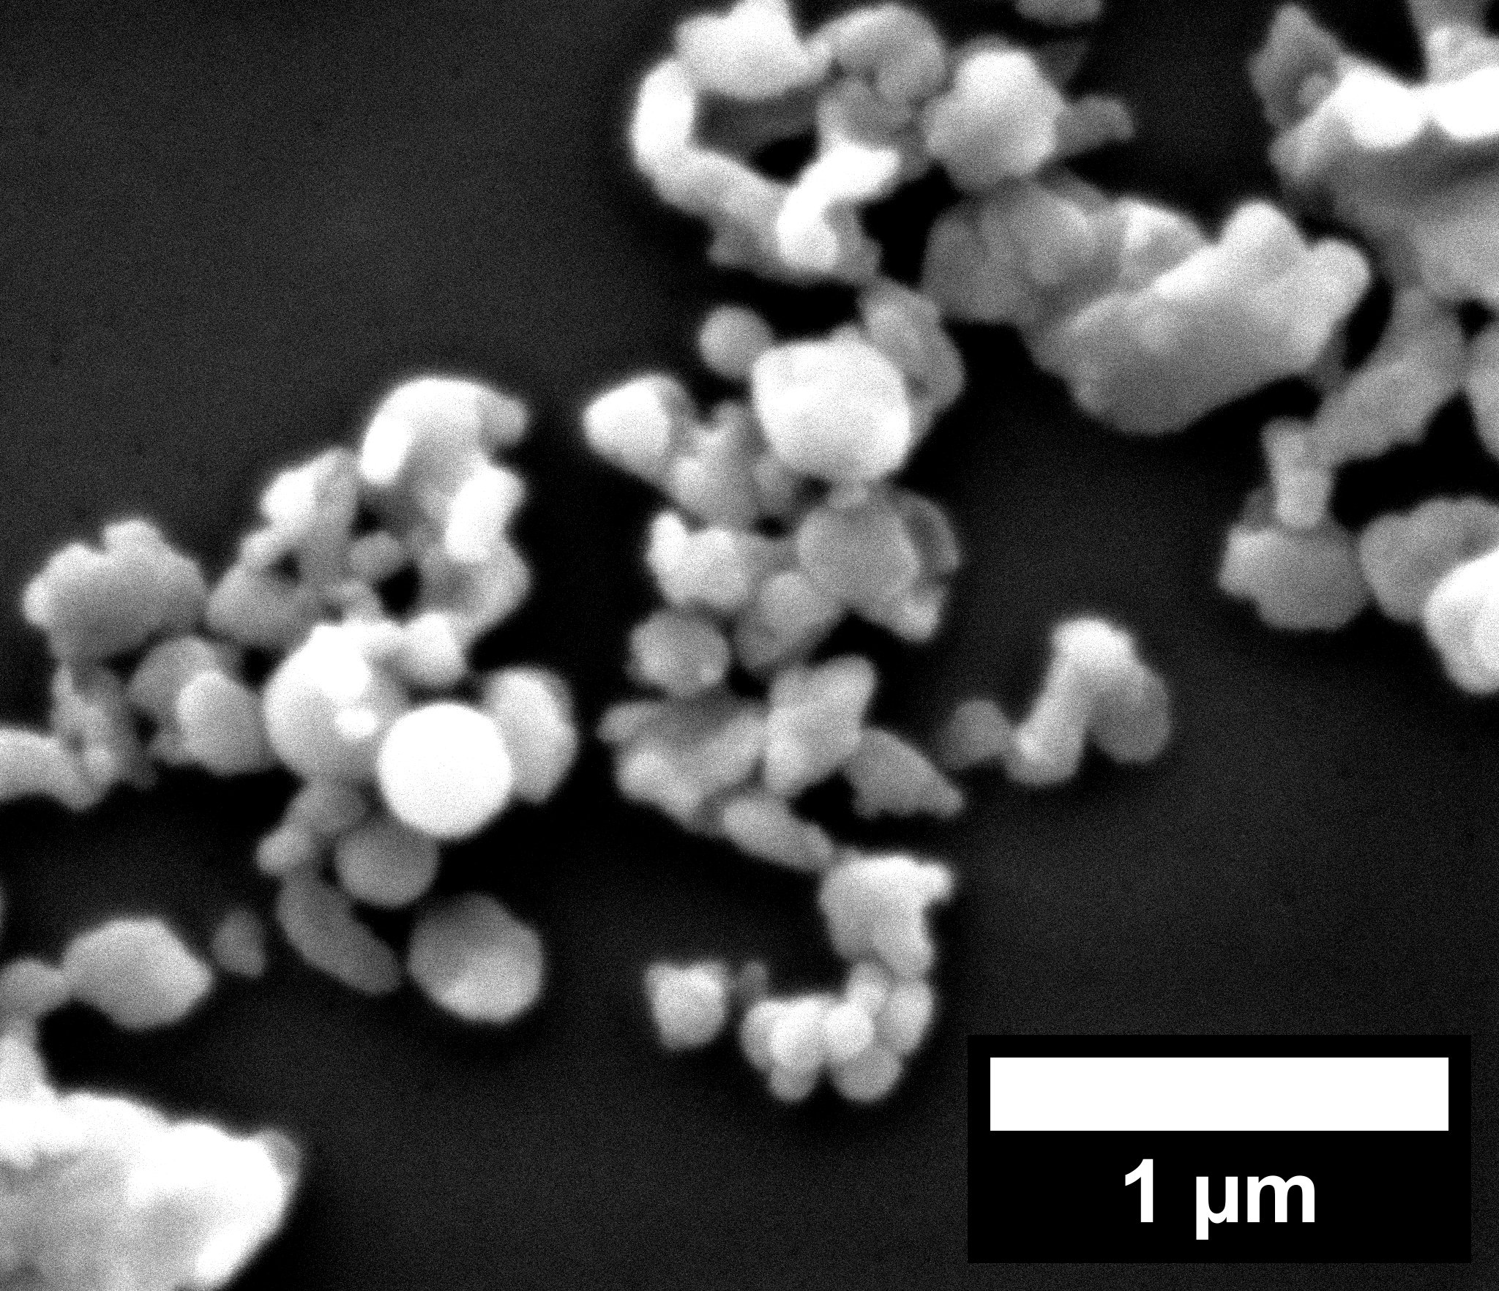

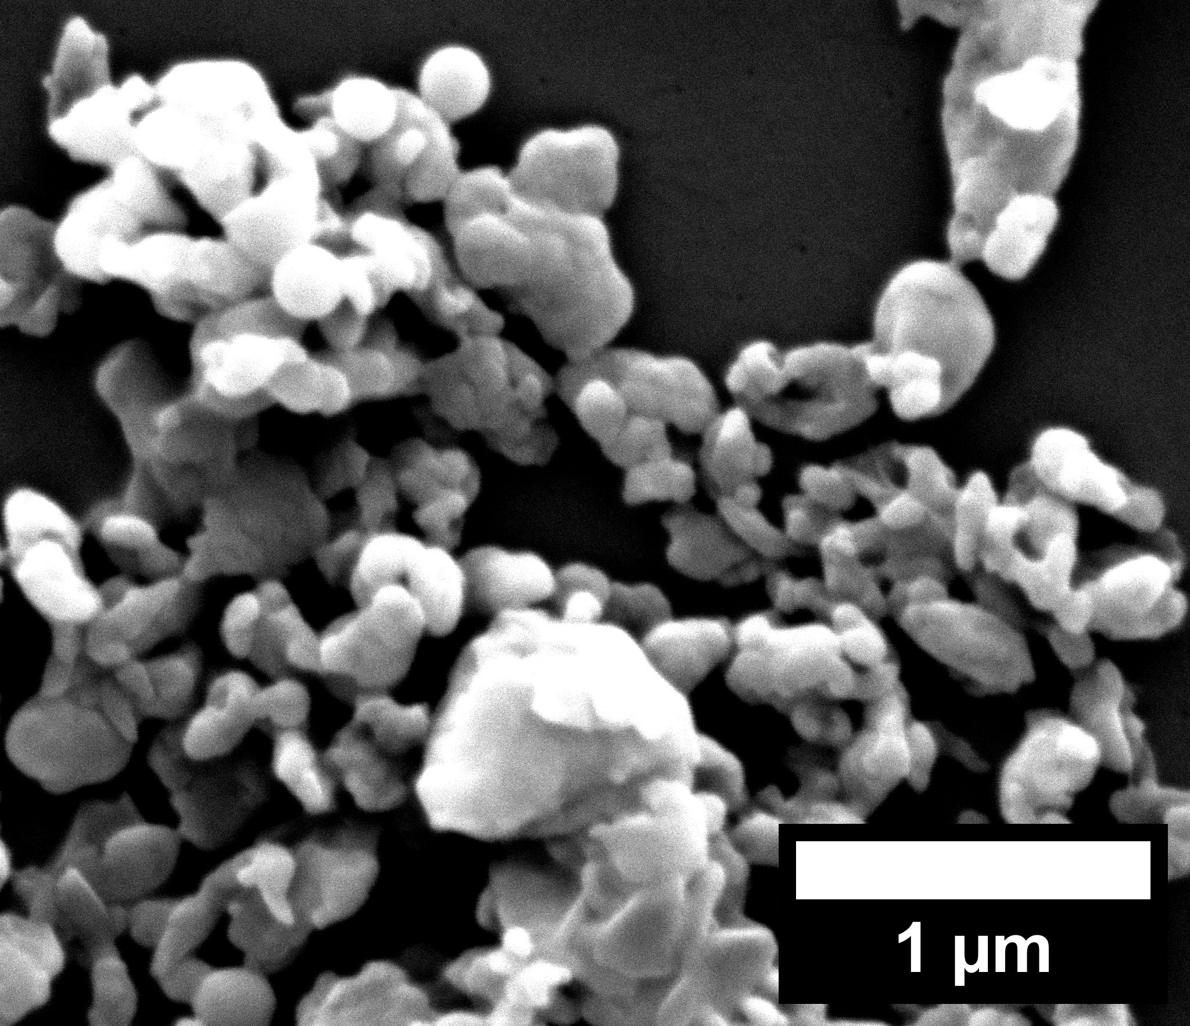
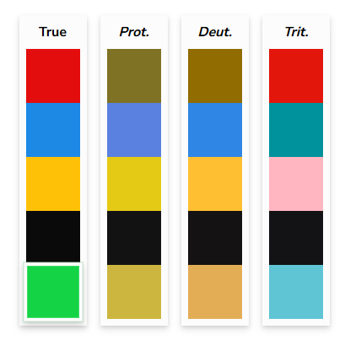
0.25% w/w
(a)
(c)
SEM
(d)
EDS
Concentration (10⁶ NPs/mL)
C
0.7% w/w
O
Se
Pt
(b)
NTA Se-PS-NPs size (nm)
2.7% w/w
Frequency (100x dilution)
spICP-MS calculated Se-PS-NPs size (nm)
Energy (keV)
Figure 3. Characterization of diluted Se-PS-NPs isolated from Se-PS-MNPs; (a) Average NTA size distribution of diluted 0.25%, 0.7%, 2.7% w/w Se-PS-NPs suspensions in Type 1 water, at ~1.59 ± 0.18 × 108 nanoparticles/mL or 1.25 ppm. Measurements were taken in triplicates; (b) sp-ICP-MS calculated size distribution of the 2.7% w/w Se-PS-NPs suspensions in Milli-Q water. Measurements were taken for three 100× dilutions in triplicates; (c) SEM images of clusters of 0.25%, 0.7%, 2.7% w/w Se-PS-NPs from top to bottom; (d) SEM-EDS average of 5-point analysis spectra for one representative sample of 0.25%, 0.7%, 2.7% w/w Se-PS-NPs. Emphasis in black box was put on the accelerating voltage of 1.37 keV, which is the Se Lα peak. Platinum coating Mα peak is shown at 2.05 keV.
Notes:
Micro and nanoparticles data NTA and sp-ICP-MS

Slide 6
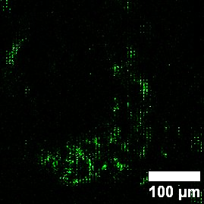
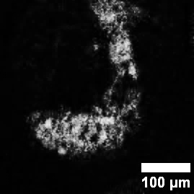
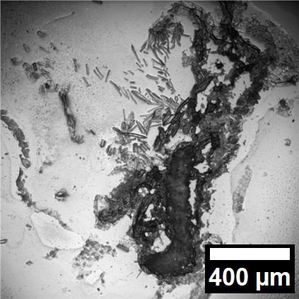
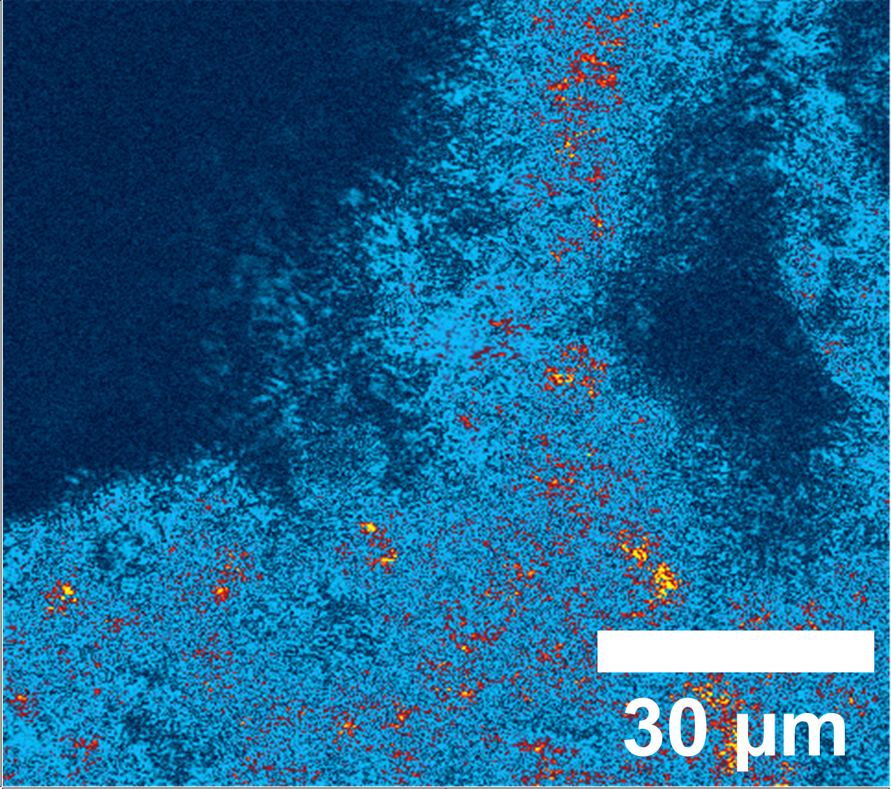
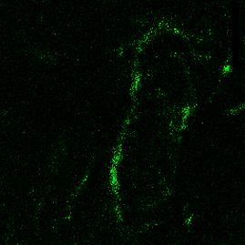
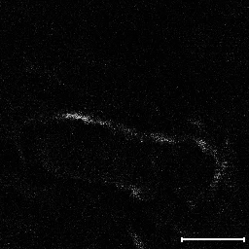
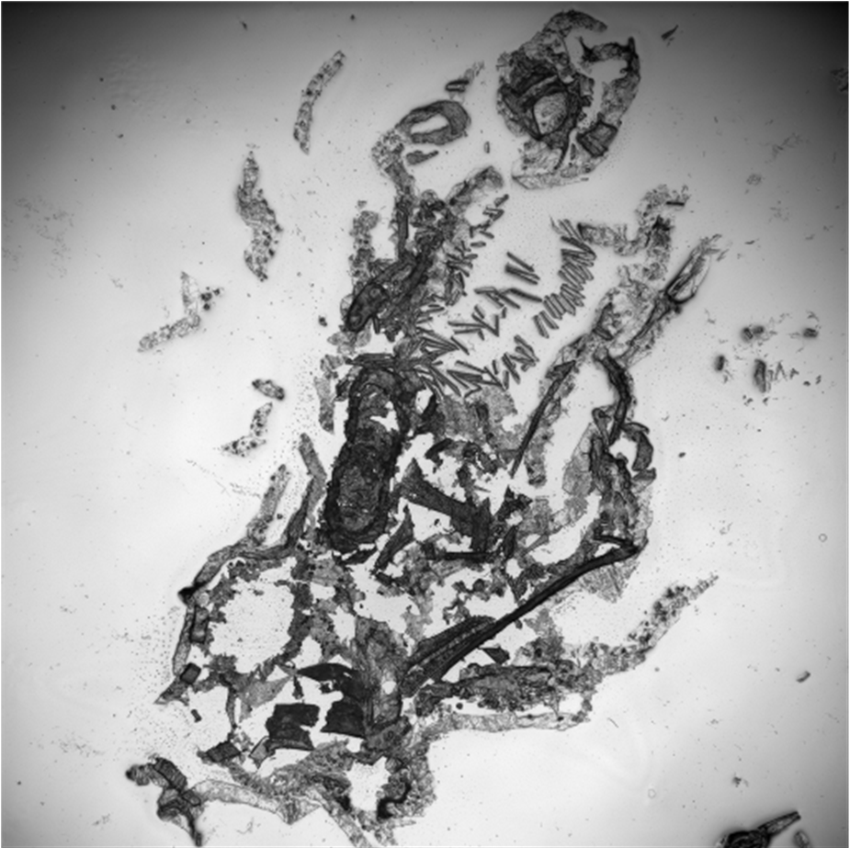
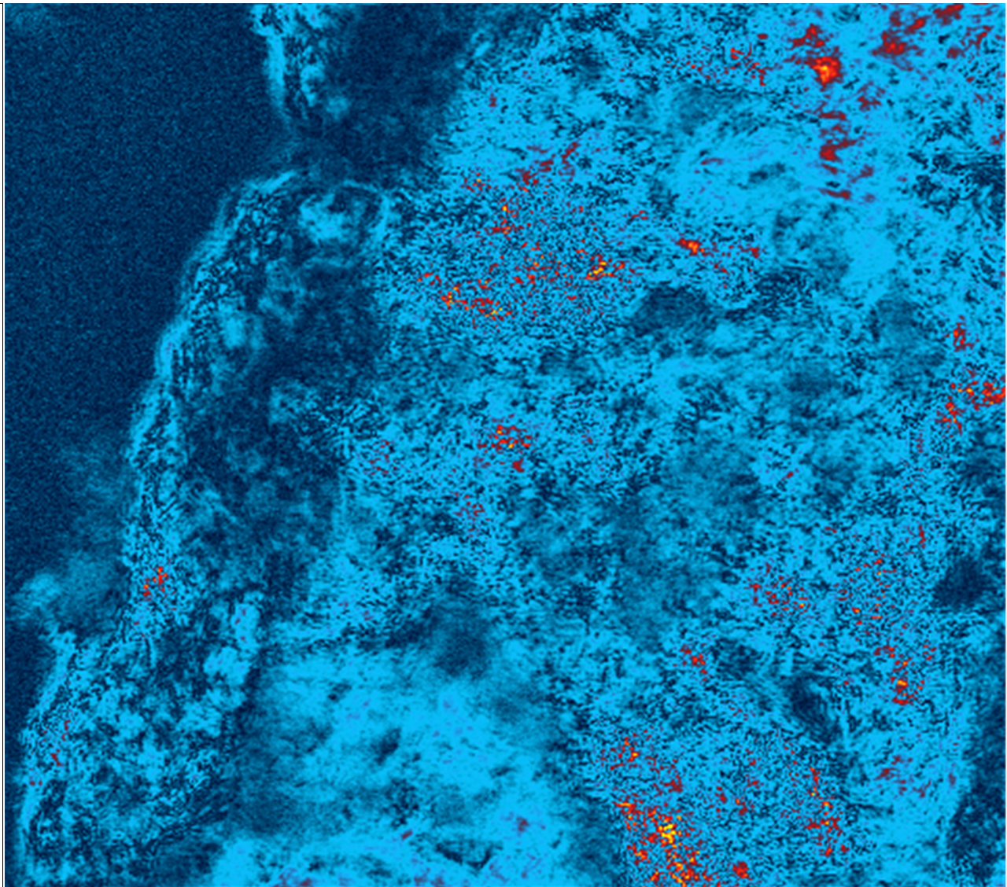
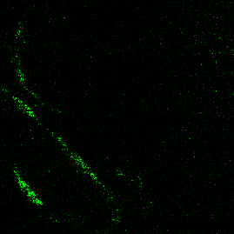

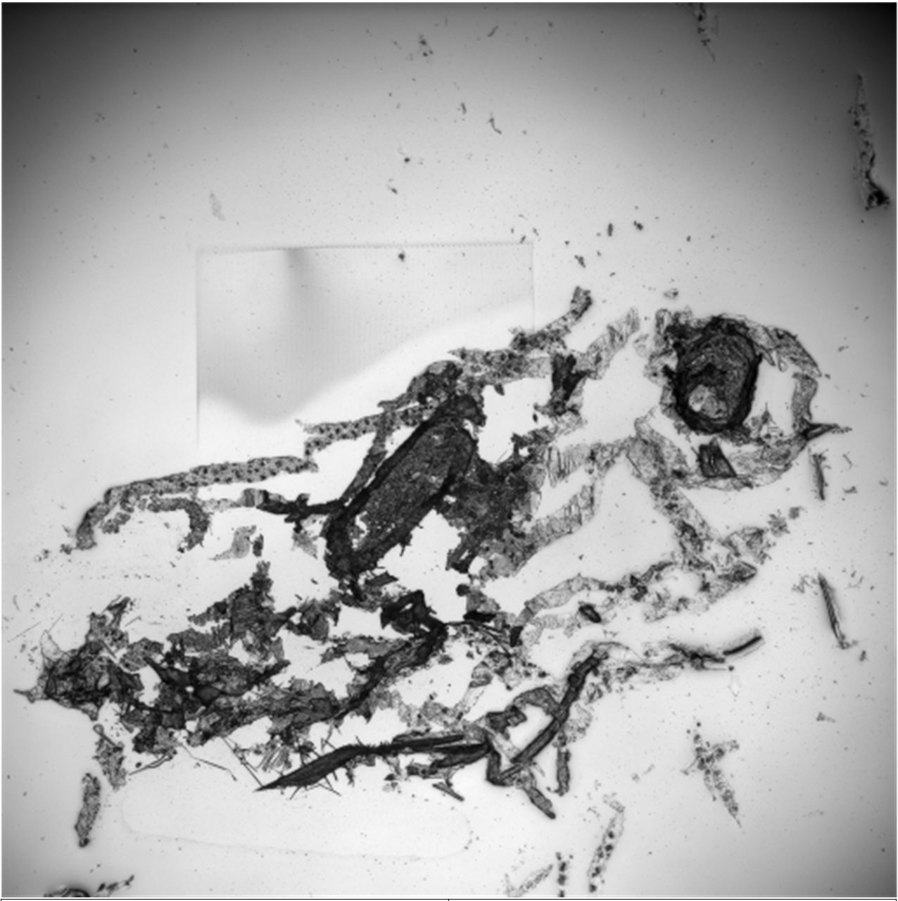
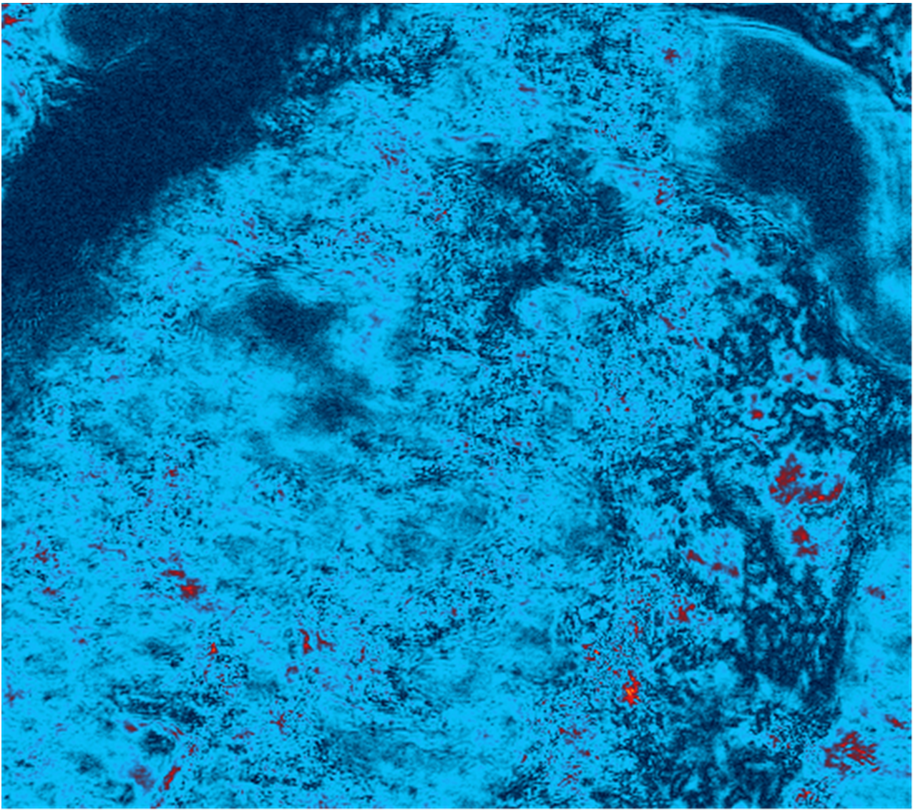
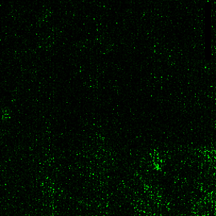

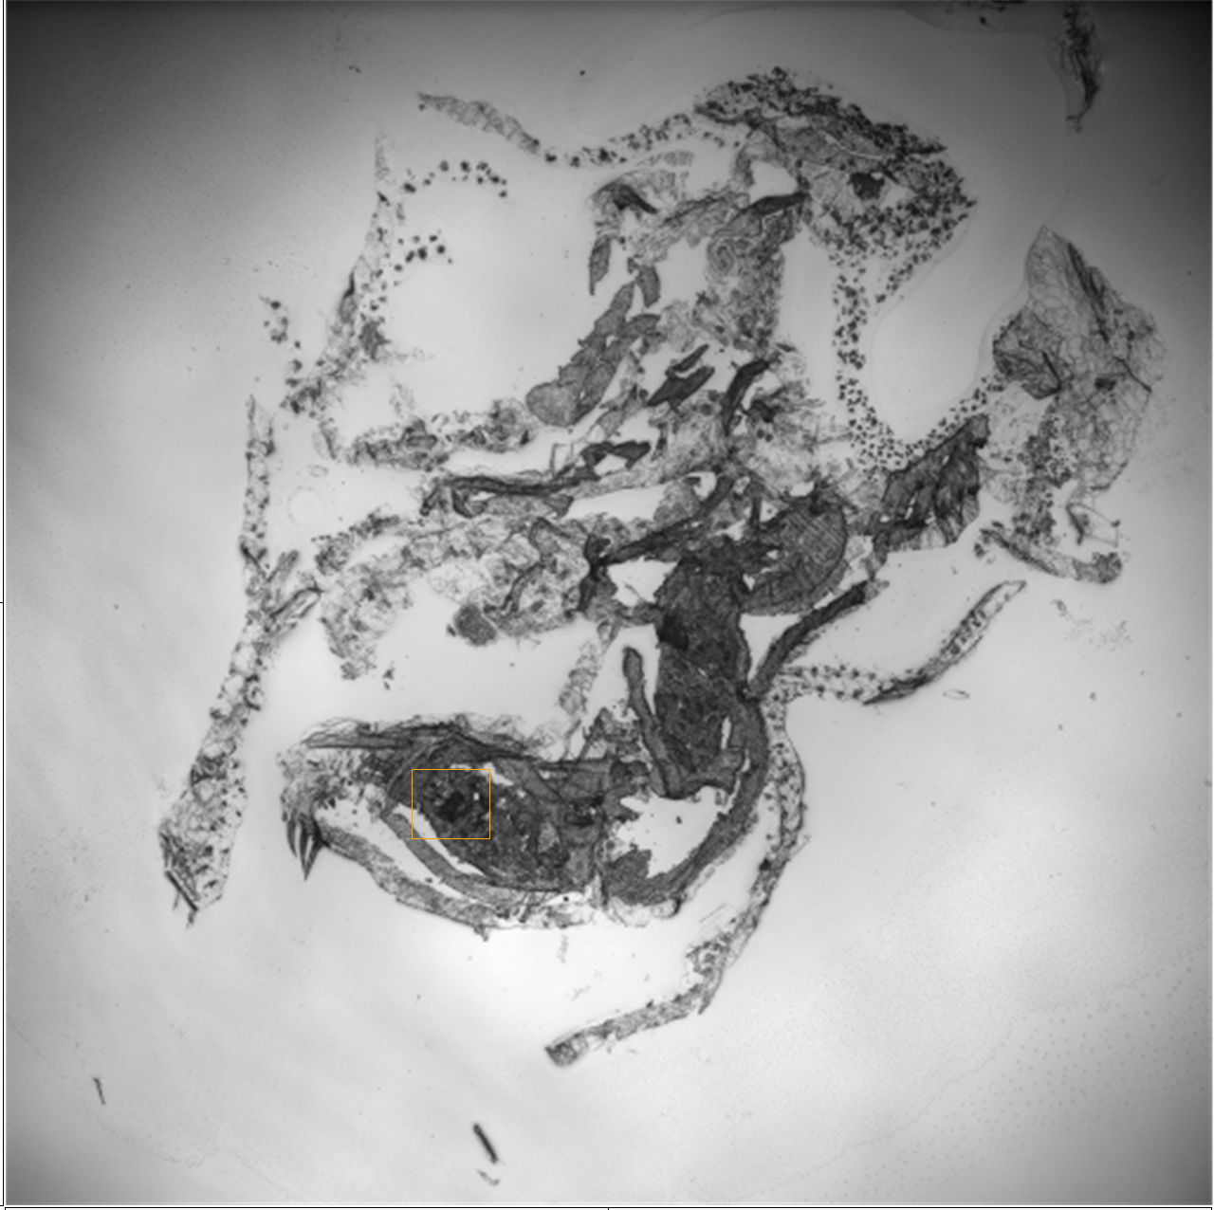
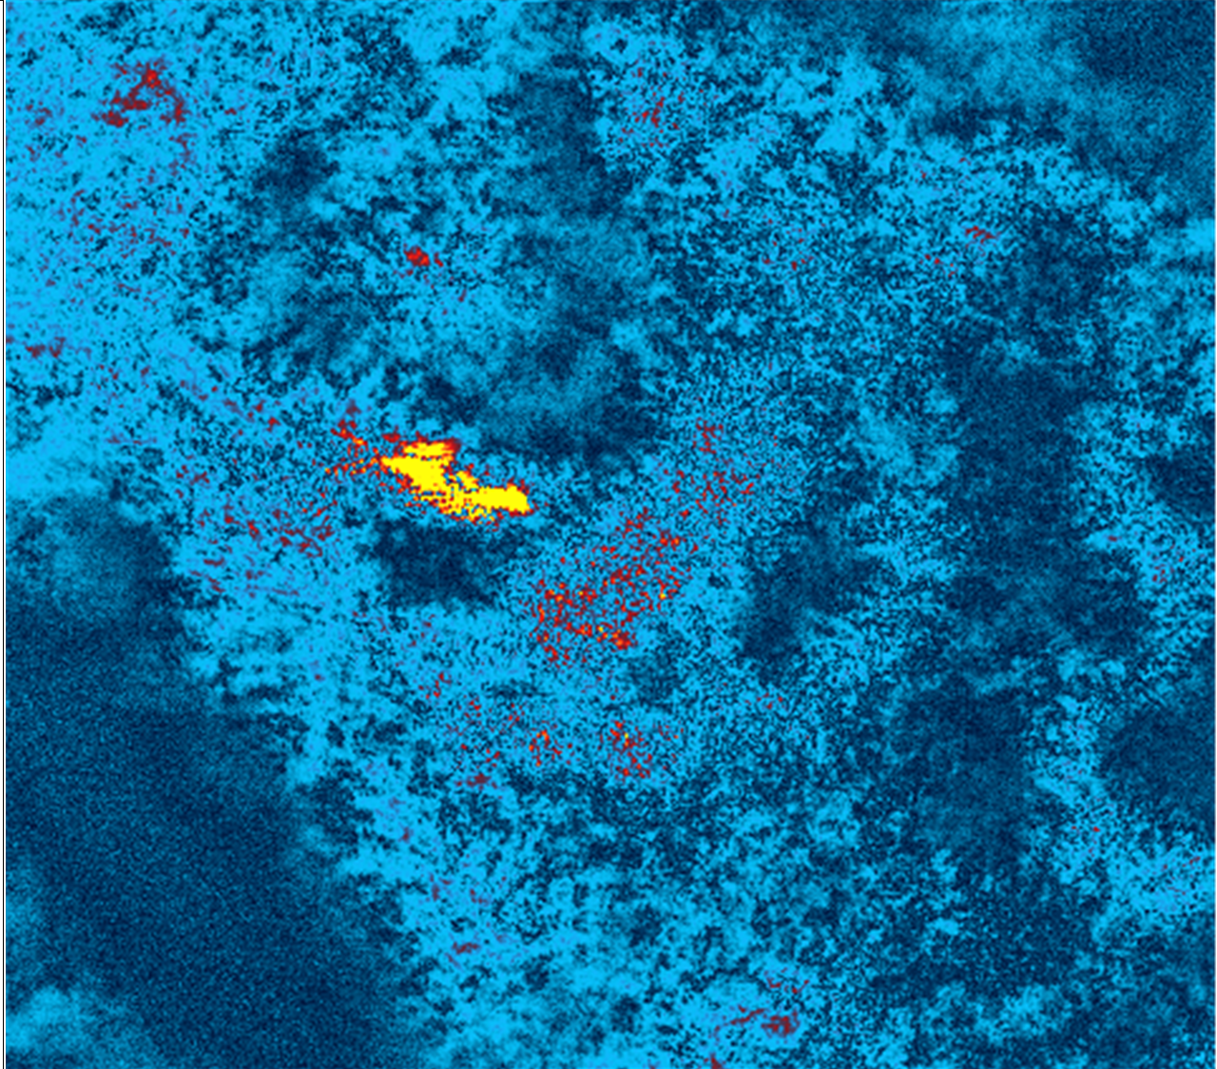
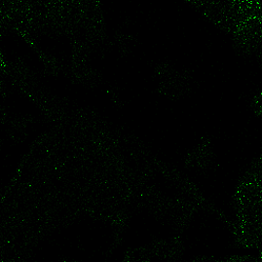
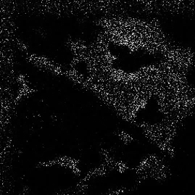
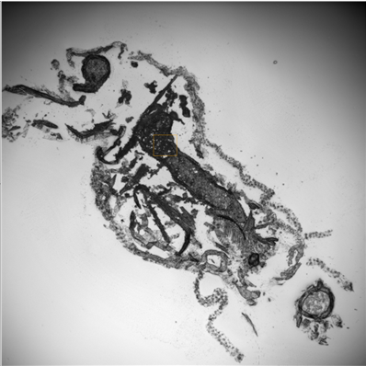
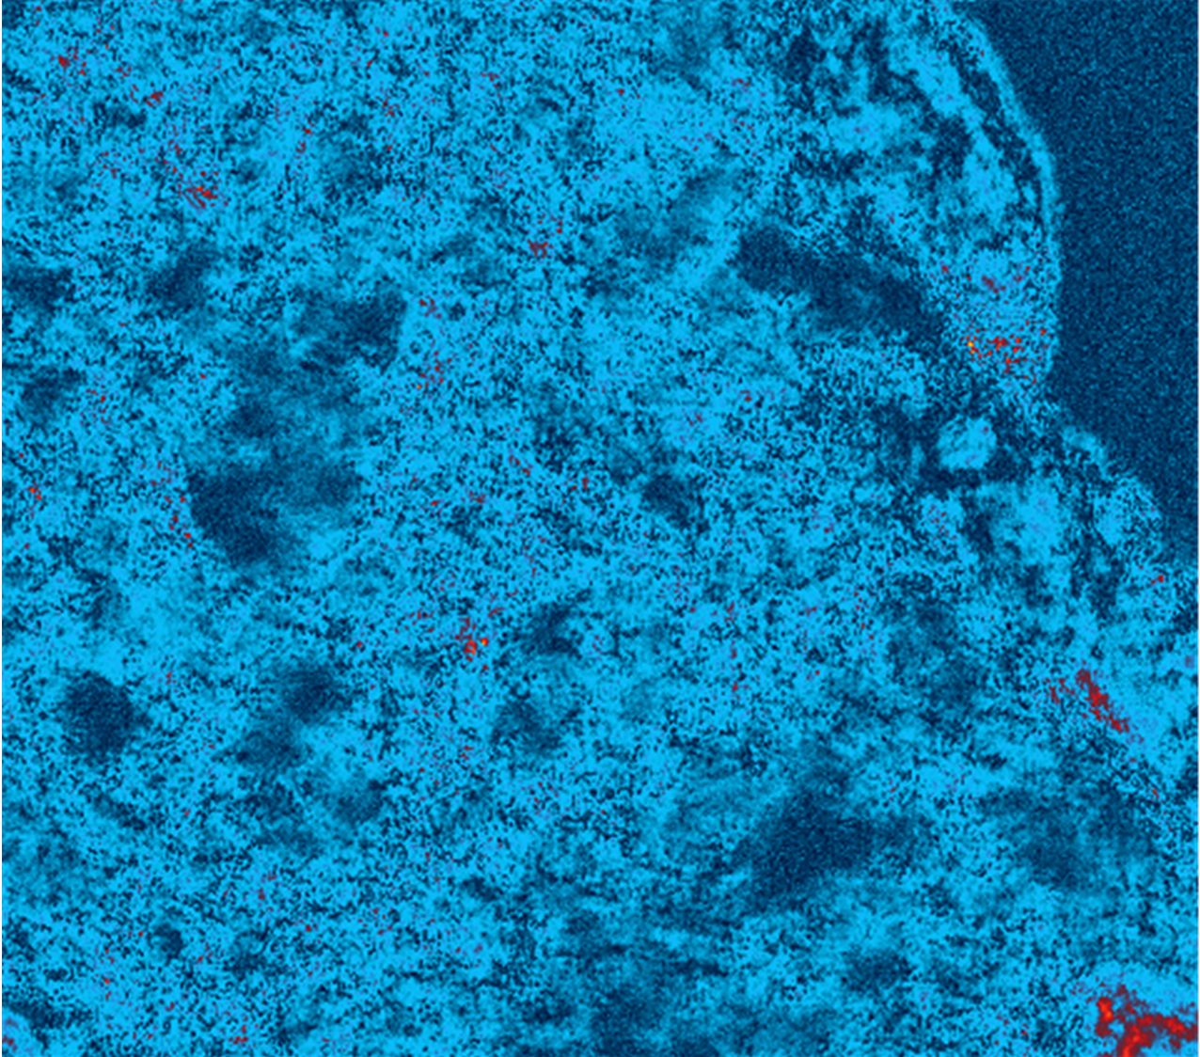
TOF-SIMS
O-PTIR
Wavenumber 1453 cm⁻¹ map
0.7% w/w Se-PS-MNPs
a)
Se⁻ map at 79.95 g/mol
C₇H₇⁺ map at 91 g/mol
Microscope image
d)
TC: 1.33 × 10⁴
b)
TC: 7.79 × 10⁴
c)
10 ppm
e)
TC: 8.03 × 10⁴
f)
TC: 4.09 × 10⁴
g)
h)
15
1 ppm
mV
i)
TC: 2.11 × 10⁴
j)
TC: 0.04 × 10⁴
k)
l)
0.7% w/w Se-PS-NPs
10
0.1 ppm
m)
TC: 6.95 × 10⁴
n)
TC: 0.19 × 10⁴
o)
p)
1 ppm
5
q)
TC: 1.35 × 10⁴
r)
TC: 3.82 × 10⁴
s)
t)
0.1 ppm
Figure 4. Localization of Se-PS-MNPs and Se-PS-NPs in histological slices of Daphnia magna exposed to 0.1, 1 and 10 ppm Se-PS-MNPs and 0.1 and 10 ppm Se-PS-NPs at 0.7% w/w Se-to-polymer ratio using nano-TOF-SIMS with negative ion selenium mapping (green) at 79.95 g/mol and positive ion styrene (C₇H₇⁺) mapping (blue) at 91 g/mol for a 400 × 400 µm region located as a red square on the O-PTIR 10× microscope image, and O-PTIR mapping at 1453 cm⁻¹ with O-PTIR colour intensity scale shown on the right side. Red and yellow indicate stronger presence for 1453 cm‑¹. Red dashed square is the location of the mapping indicated on the microscope image and nano-TOF-SIMS images; (a) Se⁻ map for 10 ppm Se-PS-MNPs exposure. (b) C₇H₇⁺ map for 10 ppm Se-PS-MNPs exposure. (c) O-PTIR 10× microscope image for 10 ppm Se-PS-MNPs exposure. (d) O-PTIR mapping at 1453 cm⁻¹ for 10 ppm Se-PS-MNPs exposure. (e) Se⁻ map for 1 ppm Se-PS-MNPs exposure. (f) C₇H₇⁺ map for 1 ppm Se-PS-MNPs exposure. (g) O-PTIR 10× microscope image for 1 ppm Se-PS-MNPs exposure. (h) O-PTIR mapping at 1453 cm⁻¹ for 1 ppm Se-PS-MNPs exposure. (i) Se⁻ map for 0.1 ppm Se-PS-MNPs exposure. (j) C₇H₇⁺ map for 0.1 ppm Se-PS-MNPs exposure. (k) O-PTIR 10× microscope image for 0.1 ppm Se-PS-MNPs exposure. (l) O-PTIR mapping at 1453 cm⁻¹ for 0.1 ppm Se-PS-MNPs exposure. (m) Se⁻ map for 1 ppm Se-PS-NPs exposure. (n) C₇H₇⁺ map for 1 ppm Se-PS-NPs exposure. (o) O-PTIR 10× microscope image for 1 ppm Se-PS-NPs exposure. (p) O-PTIR mapping at 1453 cm⁻¹ for 1 ppm Se-PS-NPs exposure. (q) Se⁻ map for 0.1 ppm Se-PS-NPs exposure. (r) C₇H₇⁺ map for 0.1 ppm Se-PS-NPs exposure. (s) O-PTIR 10× microscope image for 0.1 ppm Se-PS-NPs exposure. (t) O-PTIR mapping at 1453 cm⁻¹ for 0.1 ppm Se-PS-NPs exposure. Counts and intensity of the nano-TOF-SIMS images are provided in Figure S10, S11, S12. S13, S14.

